Slide 1

GNOOTIP
Find the music you will love
the new song recommender by GNOD

Slide 2
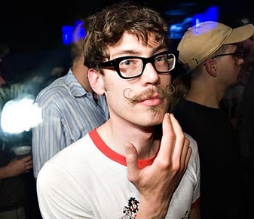
PERSONA - BIO - Harry, 32 years old
Freelance in web design
Single
Lives in London
Loves to party, hanging with friends and listening to music
Obj : finding new music
What you still need to do :
personality
tools he uses for music (discovering and listening)
goals
frustrations
motivations
favorite artist

Slide 3
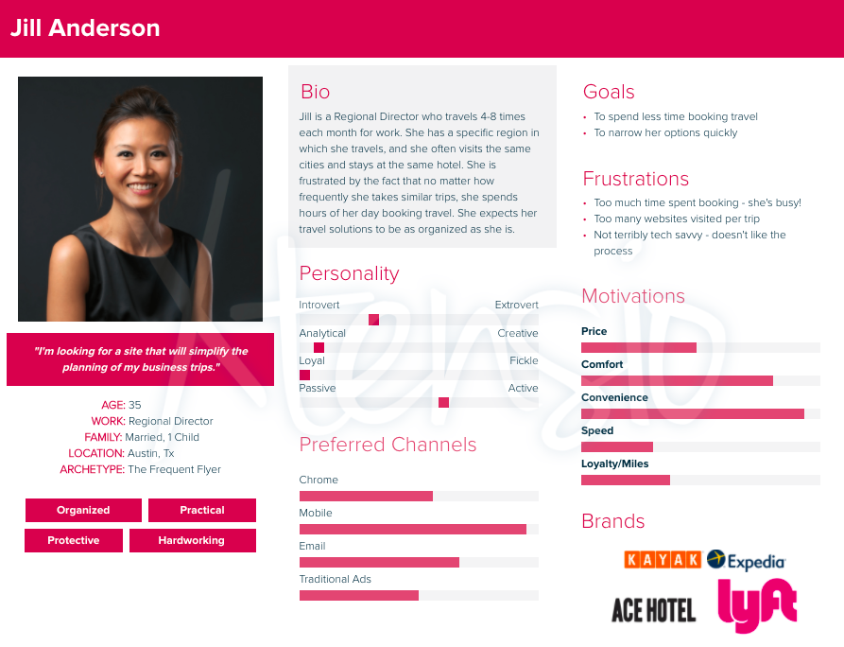
Notes:
Attention les besoins market et les besoins sales sont différents -> en général les persona en market c’est un word de 8 pages qui est ULTRA précis. Mais ne correspond pas au besoin des sales -> on a adapté l’exercice
Les besoins sales :
comment il aime que je lui parle ?
- qu’est ce qui la stresse?
quel est son enjeu ?
comment je peux l’aider ?
→ voilà à quoi un persona sales peut ressembler :)

Slide 4
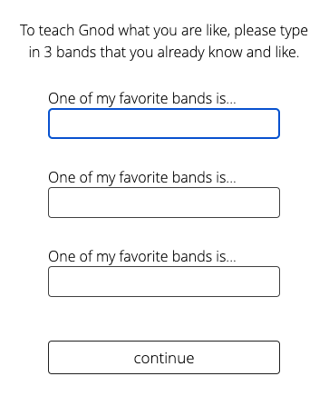
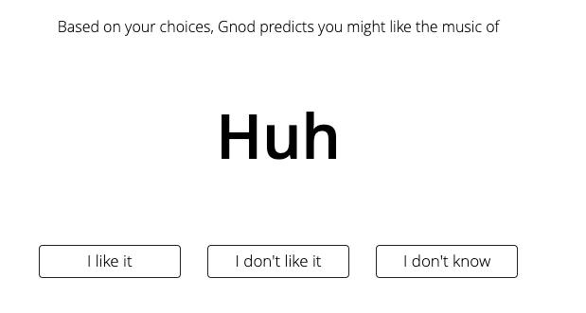
I discover Gnoosic, so happy !
I try …

Slide 5
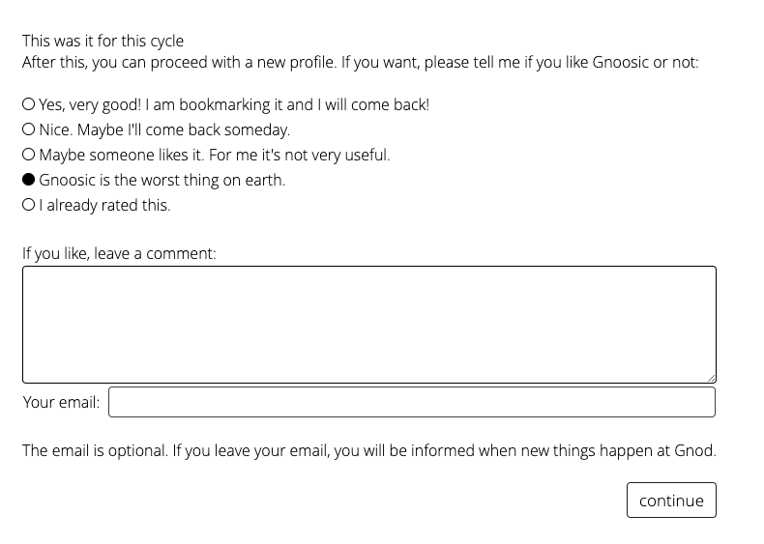
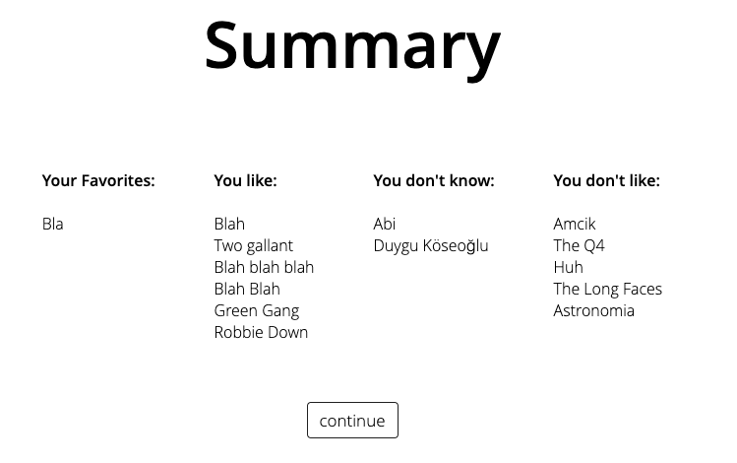
He feels so disappointed…
That’s all ??

Slide 6
TASK - see business case

Slide 7
What we came up with

Slide 8
I need more budget to :
-> add many songs and playlists to the model to increase its perf and recommend songs that are very close to the user’s input
-> create a beautiful web interface, with the videoclip and direct link to spotify url
-> communicate on this new app and share it everywhere

Slide 9
HARRY IS HAPPY

